Slide 1

Department of Information Technology
A.P. Shah Institute of Technology
G.B.Road,Kasarvadavli, Thane(W), Mumbai-400615
UNIVERSITY OF MUMBAI
Academic Year 2020-2021

Slide 2
A Project Report on
AI Based Healthcare Management System
Submitted in partial fulfillment of the degree of
Bachelor of Engineering(Sem-8)
in
INFORMATION TECHNOLOGY
By
Pranav Iyer (16104002)
Bhaskar Khekale(16104026)
Shefali Rane(16104003)
Under the Guidance of
Mrs. Rujata Chaudhari Mrs. Geetanjali Kalme

Slide 3
1.Project Conception and Initiation

Slide 4
1.1 Abstract
When the patient goes under treatment the schedule or appointment data can be handled by Doctor for the particular patient.
This system has an efficient way of accessing the medical records through an online platform.
It also eliminates the need of a local database by making use of a centrally accessible server.
This project deals with the management aspect for the local clinics. We have also considered the privacy and security aspects of the system keeping the provision of authority for patients to access the data as well as the possible threats to the system.

Slide 5
1.2 Objectives
To store the patient medical records in a better and organized manner for future references where everything will be stored as electronic records.
Use of multilingual system for better user understanding.
To fetch the data on local database will become very tedious to manage, hence making use of a centrally accessible server.
To Implement Chatbot service which will improve patient-doctor communication.

Slide 6
1.3 Literature Review
1. | Title: | The Meaningful Use Of Cloud Computing In Healthcare.
 | Author and Publisher: | Fangjian Gao,Scott Thiebes, Prof. Dr. Robert O. Briggs. Journal of Medical Internet Research,2018.
 | Description: | With its unique IT service paradigm, cloud computing can enhance traditional health IT approaches. Cloud computing provides three service models: infrastructure as a service (IaaS), platform as a service (PaaS), and software as a service (SaaS) (Mell, Grance 2011). Cloud computing can deliver either fundamental IT resources (through IaaS), IT platforms with programming languages, tools, and/or libraries for the software development or deployment (through PaaS), or ready-to-use software applications that run on cloud infrastructure (SaaS) to healthcare organizations. Moreover, cloud computing relies on four deployment models (i.e., public; private; community; hybrid) to provide IT infrastructure that enables service delivery. In a public cloud, the cloud computing service infrastructure is provided for open use by the general public, while the infrastructure of a private or community cloud is provisioned for the exclusive use of either a single organization or a specic group of organizations. A hybrid cloud is a combination of two or more of the aforementioned deployment models.

Slide 7
1.3 Literature Review
2. | Title: | Cloud-Implementation of E-Healthcare Framework.
 | Author and Publisher: | R. Vignesh,K.Mohana Prasad. International Journal of Recent Technology and Engineering (IJRTE), 2019.
 | Description: | Healthcare Systems are gaining ground around the world, seeking to provide viable and affordable healthcare to all sections of society. With the recent advancements in the Information and Communication Technology (ICT) around the globe, the Healthcare Frameworks can be made more robust with the use of more novel techniques and modern-day technologies. With the rise of Mobile Cloud Computing resources and easy availability of smartphones and net services, a proposed framework referred to as \Cloud Implementation of E-Healthcare Framework" built upon a Cloud Framework authenticated by personal biometrics would allow the agencies at work to store a patient's credentials and medical history on the Cloud which will then be accessible throughout the network which will be a significant shift from the Paper-Based Record System as well as the new and more modern Electronic-Based Record Systems. Our proposed framework is expected to enhance administrative machinery in Healthcare agencies, a more robust data frame to store patient's credentials and also time-saving procedures to provide the necessary treatment to the patient.

Slide 8
1.3 Literature Review
3. | Title: | Study of challenges to utilise mobile based health care monitoring systems: A descriptive literature review.
 | Author and Publisher: | Seyed Mohammad Ayyoubzadeh ,Journal of Telemedicine and Telecare,2018.
 | Description: | Mobile health encompasses remote and wireless applications to provide health services. Despite the advantages of applying mobile-based monitoring systems, there are challenges and limitations; understanding the challenges may assist in identifying available solutions and optimising decision-making to apply mHealth technologies more practically. This study aimed to investigate the main challenges related to mHealth-based systems for health monitoring purposes. This review was carried out through investigation of English evidence from four databases, including Scopus, PubMed, Embase, and Web of Science, using a dened search strategy from 2013 to 2017. Two independent researchers reviewed the results based on PRISMA guidelines,and data was categorised using a bottom-up approach to reach a framework for the most general challenges. Among the 105 papers obtained, eight works were selected. The revealed challenges were categorised into six main branches across a tree (with 55 nodes, four levels) including user related, infrastructure, process, management, resource and training challenges.

Slide 9
1.3 Literature Review
4. | Title: | eHealth Cloud Security Challenges: A Survey.
 | Author and Publisher: | Yazan Al-Issa,Mohammad Ashraf Ottom, Ahmed Tamrawi , Journal of Healthcare Engineering,2019.
 | Description: | Computer security is a growing eld in computer science that focuses on protecting computer systems and electronic data against unauthorized access, hardware theft, data manipulation, and against common threats and exposures such as back-doors, denial-of-service (DoS) attacks, and phishing. The objective of applying computer security measures is to attain protection of valuable data and system resources; securing system resources includes protection of a computer system hardware and software, whereas data security is more concerned with protecting data that are stored or transmitted between computer systems, as well as cloud systems. Privacy on the other hand is considered as one of the main objectives of security; it enforces certain rules and principles that regulate to what extent data about individuals or groups can be accessed, gathered, or transmitted to a second or third party. Data ownership is more related to data privacy rather than data security. Privacy could be claimed as a moral right for individuals and groups when using information systems, whereas computer security is not a moral right in itself.

Slide 10
1.3 Literature Review
5. | Title: | Security and privacy issues in e-health cloud-based system: A comprehensive content analysis.
 | Author and Publisher: | Nureni Ayofe Azeez, Charles Van Der Vyyer , Science Direct , 2018
 | Description: | The recent advancement in Information and Communication Technology(ICT) has undoubtedly improved services in all sectors in the world. Specifically , Information Technology (IT) has led to a very vital innovation in health sector called electronic health (e-Health). In order to optimize full and excellent benefits of this innovation, its implementation in a cloud-based environment is important. However , with noticeable and numerous benefits inherent from e-Health in a cloud computing, its full utilization is still being hampered by challenges of security and privacy. In this paper, we focused on extensive review of current and existing literature's of various approaches and mechanisms being used to handle security and privacy related matters in e-Health. Strengths and weaknesses of some of these approaches were enunciated.

Slide 11
1.4 Problem Definition
The proposed system is a solution to solve this problem, an internet based platform which will store the patients information in an organized manner. If any doctor wants to check the details regarding their patient’s last visit, then all they have to do is take a quick glance through the patients profile in the application.

Slide 12
1.5 Scope
In the current existing system the patient details, doctor availability details , tests undergone , medicines prescribed by the doctor is maintained manually by the receptionist in some random notebook.
This particular proposed system is aimed at developing a solution where the platform will help the Doctors to run their clinics in a better way.

Slide 13
1.6 Technology stack
Languages: Java Script, HTML ,CSS, php, python.
Testing Devices: Windows.
Chatbot : Python
Data Storage: Aws Cloud Server.
Multilingualism : Google API

Slide 14
1.7 Benefits for environment & Society
E-Health offers many benefits. That is why the government is encouraging the healthcare sector to provide more E-Health services.
The benefits include:
Time saving.
Insight into own health.
Lower administrative burden.

Slide 15
2. Project Design

Slide 16
2.1 Proposed System
The proposed solutions that we are going to deploy here is to speed-up the database response by using a Cloud Server platform rather than a local database and to reduce the time complexity by using multi-user environment.
The system after careful analysis has been identified to be presented with the following modules:
Doctor Module : The Doctor module holds the details of all the patient problem.
Patient's Module: Patient can schedule an appointment with the doctor in this module.
Admin’s Module: The Admin module is responsible for registering and assigning the doctors according to the patient’s requirement.

Slide 17
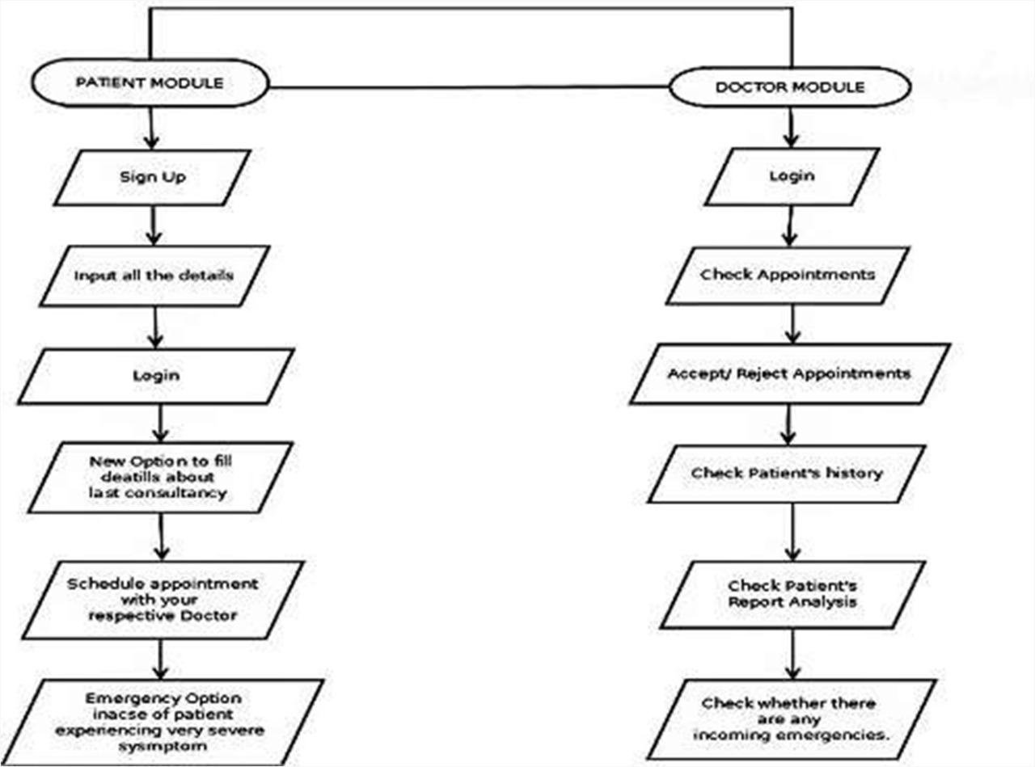
2.2 Design(Flow Of Modules)

Slide 18
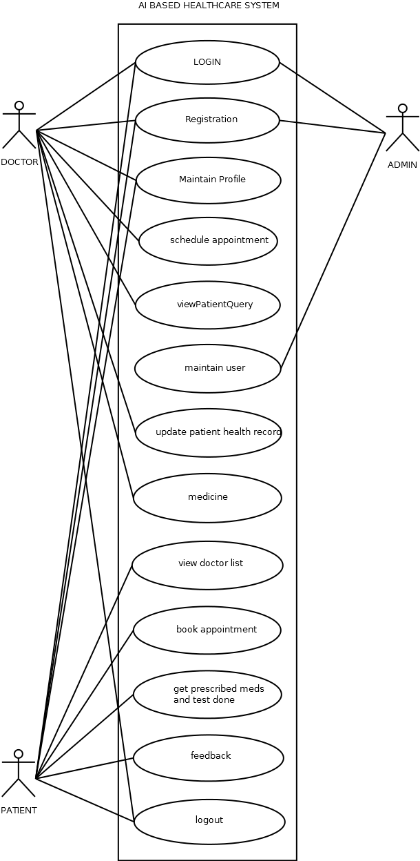
2.3 Description Of Use Case

Slide 19
2.3 Description Of Use Case
Doctor:-
Login and check his appointments.
Prescribe medicines , diet.
Patient:-
Schedule appointment.
Interact with chatbot regarding queries related to doctors or in general health.
Admin:-
Add/Remove Doctor.

Slide 20
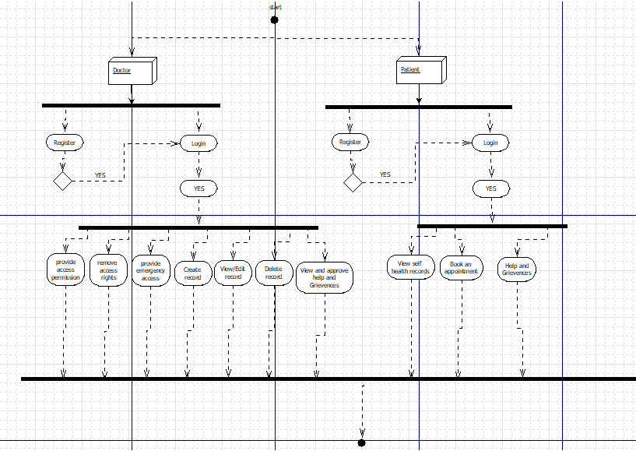
2.4 Activity diagram

Slide 21
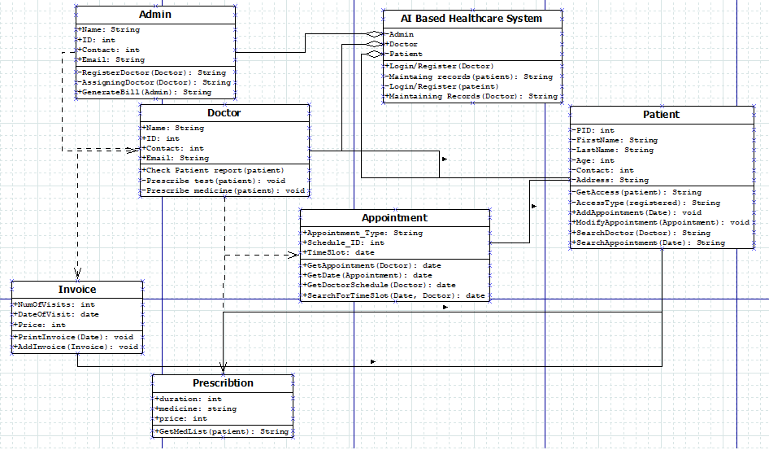
2.5 Class Diagram

Slide 22
2.6 Module-1
LOGIN AND REGISTRATION
Login and registration is the first step to start any system.
This module is essential for security purpose as it is a process of verifying someone’s identity by using pre-required details.
When a doctor or patient registers for an account, they create their unique email and password which will allow them to access their account later on.

Slide 23
Module-2
CHECKING AND SCHEDULING APPOINTMENT
Patients can check whether the required doctor is available or not and then book an appointment.
Doctors can then check their schedule and accordingly approve the requested appointment or reschedule it.

Slide 24
Module-3
CONSULTATION AND BILL GENERATION
The patient after consulting the doctor can thereby download the prescription of the recommended medicine.
The bill is also generated at the end.
Both the prescription and bill can be downloaded in the pdf format.

Slide 25
3. Conclusion and Future Scope

Slide 26
Thus to summarize this project is aimed in helping both Medical frontline workers as well as to the public.
Our proposed system is aimed at developing a solution where the system will help Doctors running a local clinic in a better way.
This has also reduced the spaced occupied by the files and provide adequate security for patient’s medical record.
This concludes the importance and indispensable nature of the computer and its application in the hospital.

Slide 27
References
1] R. Vignesh, K.Mohana Prasad On, \Cloud-Implementation of E-Healthcare Framework", International Journal of Recent Technology and Engineering (IJRTE),(2019).
2] Seyed Mohammad Ayyoubzadeh On. \Study of challenges to utilize mobile-based healthcare monitoring systems: A descriptive literature review", Journal of Telemedicine and Tele-care(2018).
3] Yazan Al-Issa, Mohammad Ashraf Ottom, Ahmed Tamrawi On, \eHealth Cloud Security Challenges: A Survey", Journal of Healthcare Engineering(2019).
4] Nureni Ayofe Azeez, Charles Van Der Vyyer On, \Security and privacy issues in e-health cloud-based system: A comprehensive content analysis", Science Direct(2018).

Slide 28
Thank You

